Slide 1
SALES ANALYSIS AMAZON PRODUCTS
Rushikesh Burle
Data Analyst , Ss Infotech
rushikesh.ssinfotech@gmail.com

Slide 2



INTRODUCTION
Amazon is an American multinational technology company, engaged in e- commerce, cloud computing, online advertising, digital streaming, and artificial intelligence
Amazon was founded on July 5, 1994, by Jeff Bezos in Bellevue, Washington
The company originally started as
an
to include a wide range of product
online marketplace for books but
gradually expanded its offerings
categories.
The company has multiple subsidiaries, including Amazon Web Services, providing cloud computing, Zoox, a self-driving car division, Kuiper Systems, a satellite Internet provider, and Amazon Lab126, a computer hardware R&D provider.
Amazon.com is an e-commerce including media (books, movies,
platform that sells many product lines, music, and software), apparel, baby
products, consumer electronics, beauty products etc
In December 2023, Amazon.com had approximately 2.27 billion combined web visits, down from 2.6 billion visits in November.
Net sales increased 12% to $574.8 billion in 2023, compared with $514.0 billion in 2022

Slide 3


PROBLEM STATEMENT
KPI'S REQUIREMENT
YTD Sales: Monitor year-to-date sales to gauge the overall revenue performance over time.
QTD Sales: Track quarterly sales figures to identify sales trends and fluctuations.
YTD Products Sold: Analyse the total number of products sold throughout the year to understand product movement.
YTD Reviews: Keep tabs on year-to-date product reviews to assess customer feedback and satisfaction.

Slide 4
PROBLEM STATEMENT
CHARTS REQUIREMENTYTD
Sales by Month (Line Chart): Visualize sales trends over time on a monthly basis to identify seasonal patterns and growth trends.
YTD Sales by Week (Column Chart): Display sales data on a weekly basis to pinpoint shorter-term fluctuations and performance insights.
Sales by Product Category (Text/Heat Map): Utilize a text or heat map visualization to provide a high- level overview of sales across different product categories.
Top 5 Products by YTD Sales (Bar Chart): Highlight the top-performing products based on year-to-date sales to focus on key revenue generators.
Top 5 Products by YTD Reviews (Bar Chart): Identify the top-rated products by year-to-date reviews to understand customer preferences

Slide 5
Dashboards

Slide 6
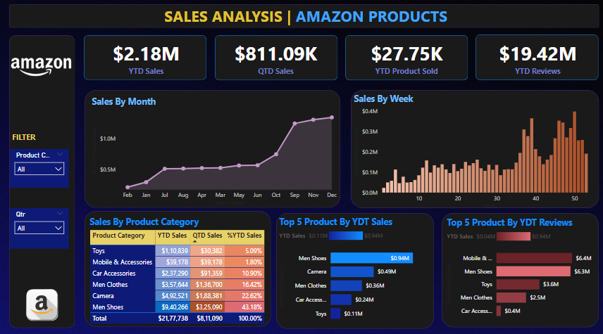

Slide 7
THANK YOU

